Slide 1
A Coupled User Clustering Algorithm for Web-based Learning Systems
Ke Niu, Zhendong Niu, Xiangyu Zhao,
Can Wang, Kai Kang, Min Ye

Slide 2
Contents
1
Introduction
2
Clustering Model
3
Clustering Algorithm
4
Experiments and Evaluation
5
Conclusions

Slide 3
Introduction
Web-based learning is a significant and advanced way of education, meaning to utilize computer network technology, digital multimedia technology, database technology and other modern information technology to learn in digital environment.
With many of the previous algorithms utilized in Wed-based learning systems, learners’ attribute information is extracted by analyzing their behaviors, and finally used for user clustering. However, these algorithms generally neglect the explicit and implicit coupling relationships of user attributes and this may lead to massive significant information loss.

Slide 4
Introduction
This paper proposed a coupled user clustering algorithm for Web-based learning systems, namely CUCA. It studies the coupling relationships of user attributes. With the help of Taylor-like expansion, we use a spectral clustering algorithm to cluster users.
When it is applied in Web-based learning systems, it can efficiently capture learners’ behavior features and analyze the information behind them, especially that of “unnormal” group of learners, and finally use them to provide personalized learning services.

Slide 5
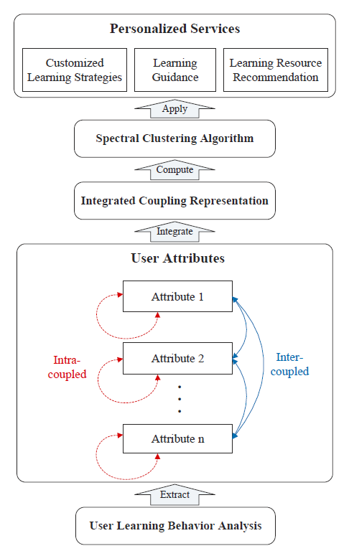
Clustering Model
In this section, the coupled user clustering model is illustrated. This model captures coupling relationships of user attributes through online behavior analysis, and uses spectral clustering algorithm to improve clustering accuracy.

Slide 6
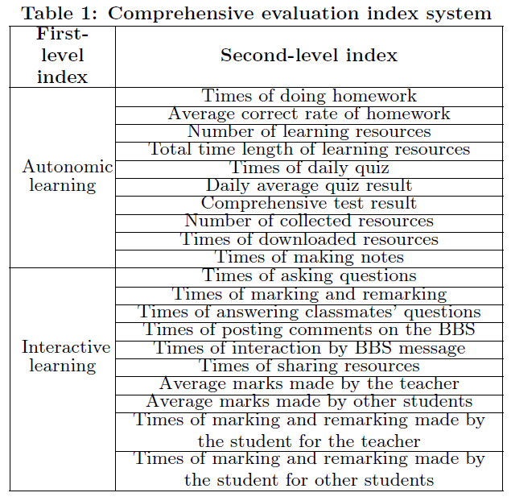
Clustering Algorithm
Based on the model illustrated in section 2, this paper proposed an online coupling user clustering algorithm.
1) User learning behavior analysis
We refer to a Web-based personalized user evaluation model and utilizes its evaluation index system to extract students’ attributes information.

Slide 7
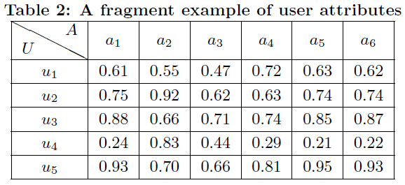
Clustering Algorithm
2) Intra-coupled and inter-coupled representation
We use CUCA to represent the intra-coupled and inter-coupled
interactions of the 6 attributes of 5 students.
a1~a6
Average correct rate of homework
Times of doing homework
Number of learning resources
Total time length of learning resources
Daily average quiz result
Comprehensive test result

Slide 8
Clustering Algorithm
The common way to calculate the interactions between 2 attributes is Pearson’s correlation coefficient

Slide 9
Clustering Algorithm
We take the p values for testing the hypotheses of no correlation between attributes into account.
a. Intra-couple relationship presentation

Slide 10
Clustering Algorithm
b. Inter-coupled interaction

Slide 11
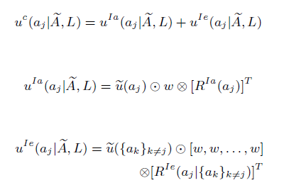
Clustering Algorithm
3) Integrated coupling representation

Slide 12
Clustering Algorithm
4) User Clustering
With the global couple representation, we can do user clustering using NJW.

Slide 13
Experiments and Evaluation
1) User study
we ask 220 users (signified by s1; s2; : : : ;s220) to learn C programming language online and then do self-assessment, teacher-assessment and peer-assessment respectively from perspectives of learning attitude and learning
effect.

Slide 14
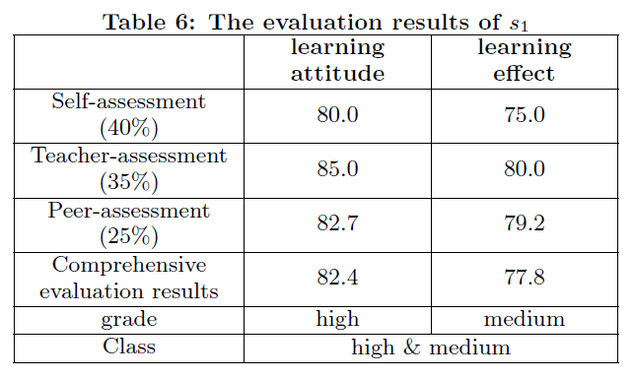
Experiments and Evaluation
Example of evaluation result

Slide 15
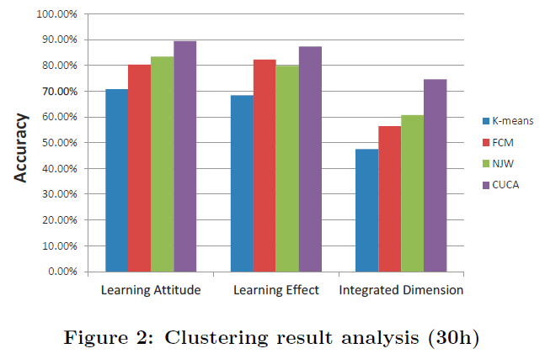
Experiments and Evaluation
2) User clustering
We do user clustering respectively with K-means algorithm, Fuzzy C-means algorithm(FCM), NJW algorithm and CUCA algorithm, getting 2 labels in terms of learning attitude and learning effect for each student.
3) Clustering result and comparison

Slide 16
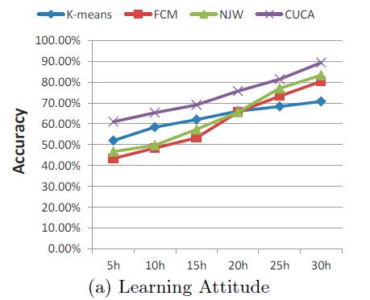
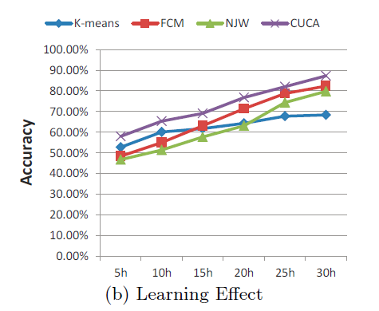
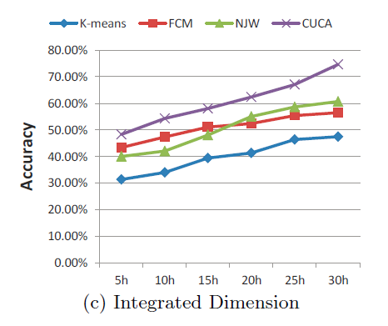
Experiments and Evaluation

Slide 17
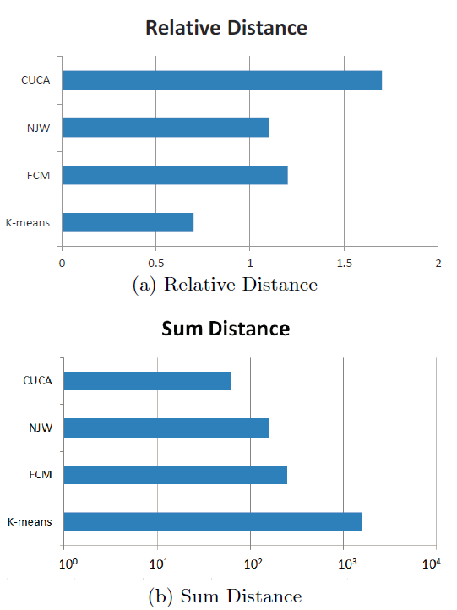
Experiments and Evaluation

Slide 18
Conclusion
CUCA is proposed in this paper to capture coupling relationships of user attributes. The algorithm respectively takes intra-coupled and inter-coupled correlation into account in the application process, and utilizes Taylor-like expansion to represent the coupling relationship. Finally, with the usage of spectral clustering algorithm, CUCA is applied to do user clustering. In the experiments, user study, user clustering and result analysis are adopted to verify that CUCA outperforms traditional algorithm for user clustering.

Slide 19
Thank You !

