Slide 1
Pre-Assessment questions tiny.cc/kenpre
Cognitive Task Analysis leads to improved course design because
  Such analysis helps instructions identify better ways to support learning of the content they know so well
  “Expert blind spot” leaves holes in what instructions know about learner difficulties and how to design to address them
  As much as 70% of the expertise instructors want students to learn is outside of instructors’ conscious awareness
Junior high school students have difficulty in “symbolizing”, that is, in translating a story problem (e.g., “Anne is 800 meters from home & walking 40 meters per minute …”) to a symbolic algebraic expression (e.g., “800-40x”) primarily because
  It is hard to understand the mathematical structure expressed in the story problem
  It is hard to express an understood mathematical structure in algebraic symbols
Which kind of tutored practice produces more learning transfer to symbolizing?
  Tutored practice on translating one operator story problems into algebraic expressions
  Tutored practice on substitution problems, such as “substitute 40x for y in 800-y”
Regarding “close the loop” experiments in EDM:
  We need more otherwise it will remain unclear whether our mining methods mean anything
  We have just enough
  We have more than enough as EDM should focus on mining methods not on scientific insights or applications coming from them
Ultimately, an EDM algorithm is best evaluated by:
  Showing it accurately predicts data through cross validation
  Showing it more accurately predicts data than other existing algorithms
  Showing that use of it or an insight derived from it produces better student learning

Slide 2

Closing the Loop with Quantitative Cognitive Task Analysis
Ken Koedinger & Mimi McLaughlin
pact.cs.cmu.edu/koedinger.html
Professor of Human-Computer Interaction
Carnegie Mellon University
Director of
learnlab.org
PI of
learnsphere.org
Educational Data Mining
July 2, 2016
Notes:
My talk will combine elements from education disciplines (math ed, pyschometrics), as well as cognitive psychology and computer science. Like fusion cuisine.
You may prefer authentic food -- your own discipline -- but I hope to help you develop a taste, if you don’t have one already, for interdisciplinary fusion.

Slide 3

Experts can describe only 30% of what they know!
(Clark et al)
What we know about our own learning
What we do not know we know
=> Instructor-based intuitive design lacks information and thus is flawed
Notes:
See YouTube videos
Our over-estimated sense that we understand our own learning leads us astray in making educational decisions -- it yields a tendency toward the quick fix or one size fits all solution.
From Clark & Estes, 2006: “The importance of CTA is based on compelling evidence that experts are not fully aware of about 70% of their own decisions and mental analysis of tasks (Clark and Elen, 2006; Feldon and Clark, 2006) and so are unable to explain them fully even when they intend to support the design of training, assessment, job aids, or work.”

Slide 4

Cognitive Task Analysis uncovers hidden skills => improves instruction
Cognitive Task Analysis (CTA) Methods
  Structured interviews, think alouds of experts
Studies: Traditional instruction vs. CTA-based
  Med school catheter insertion
  (Velmahos et al., 2004)
  Radar system troubleshooting
  (Schaafstal et al., 2000)
  Spreadsheet use (Merrill, 2002)
Lee (2004) meta-analysis:
1.7 effect size!
Notes:
Med school surgery (Velmahos et al., 2004)
Catheter placement & insertion
lecture/demonstration/practice sequence either based on CTA of 2 experts or traditional instruction
sig greater pre to post gain
better with patients on all 4 measures of performance (including needle insertion attempts!)
Radar system troubleshooting (Schaafstal et al., 2000)
pre-existing course vs. new CTA-based version
Ss in CTA-based course solved 2x malfunctions & in less time
Spreadsheet use (Merrill, 2002)
CTA-based direct instruction vs. trad DI (commerical product) vs. discovery learning
CTA: strategies elicited from a spreadsheet expert
Post-test: 89% vs. 64% vs. 34%
Only half of the time!
Lee (2004) meta-analysis: 1.7 effect size!
7 studies with 39 comparisons

Slide 5
Quantitative
Cognitive Task Analysis (CTA)
Complementary to qualitative CTA
  Pro: Greater reliability & less costly
  Con: Harder to interpret than interview CTA data
Quantitative CTA methods
  Difficulty Factors Assessment
    Students better at story problems than matched equations
    => tutor redesign better in close-the-loop (Koedinger & Anderson, 1998)
  Statistical models of learning (BKT, AFM, PFA, …)
    Discovered hidden planning skills in geometry area
    => tutor redesign better in close-the-loop
    Automating model search in Learning Factors Analysis
    => close-the-loop coming…

Slide 6
There isn’t much “E” in “EDM” without interpretation!
3 ways model interpretation improves educational theory & practice
Advances scientific understanding of learning or of domain content
Facilitates generalization of models to new data sets (cf., Liu…, EDM14)
Produces insights that lead to improved ed tech design

Slide 7
Assumptions behind of Quantitative Cognitive Task
Task difficulty variation => KC inferences
KC’s predict learning transfer
  & guide better instructional design
Assumption is present in logistic regression (AFM) & BKT family models of learning curves
  The same KC matrix is used for both task difficulty (β or L0) learning transfer (γ or T)
  Models using same KC matrix to predict difficulty and transfer produce better results than using separate matrices (item vs. KC)
Goal: further investigate this difficulty-transfer linkage claim
Koedinger, Yudelson & Pavlik (in press). Testing theories of transfer using Error Rate Learning Curves. Topics in Cognitive Science Special Issue.

Slide 8
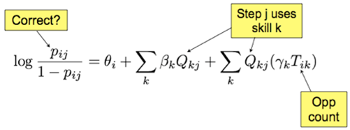
AFM: KC model (Q) is used for both difficulty (β) & transfer (γ) prediction
GIVEN:
pij = probability student i gets step j correct
Qkj = each knowledge component k needed for this step j
Tik = opportunities student i has had to practice k
ESTIMATED:
θi = proficiency of student i
βk = difficulty of KC k
γk = gain for each practice opportunity on KC k
Cen, Koedinger, & Junker (2006)
Draney, Pirolli, & Wilson (1995)
Spada & McGaw (1985)

Slide 9
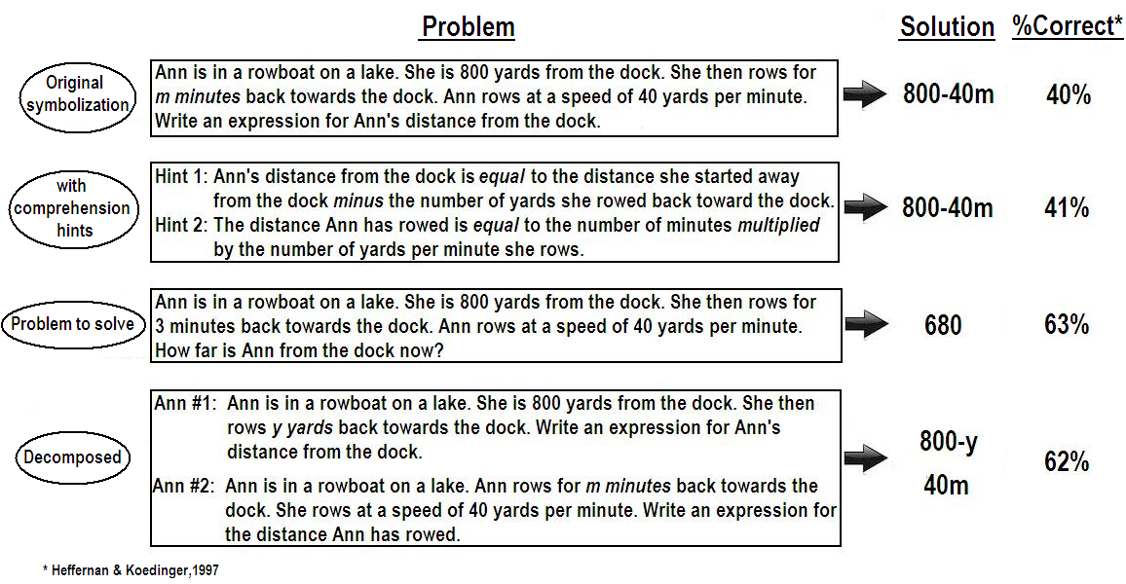
Why is symbolization hard?

Slide 10
What can we do to improve learning of symbolizing?
2_step | 1_step | 1_step | substitution
Ms. Lindquist teaches 62 girls. Ms. Lindquist teaches f fewer boys than girls. Write an expression for how many students Ms. Lindquist teaches. | Ms. Lindquist teaches 62 girls. Ms. Lindquist teaches b boys. Write an expression for how many students Ms. Lindquist teaches. | Ms. Lindquist teaches 62 girls. Ms. Lindquist teaches f fewer boys than girls. Write an expression for how many boys Ms. Lindquist teaches. | Substitute 62-f for b in 62+b Write the resulting expression.
62+62-f | 62+b | 62-f | 62+62-f
Notes:
Table 1. Examples of problem variations and their solutions.

Slide 11
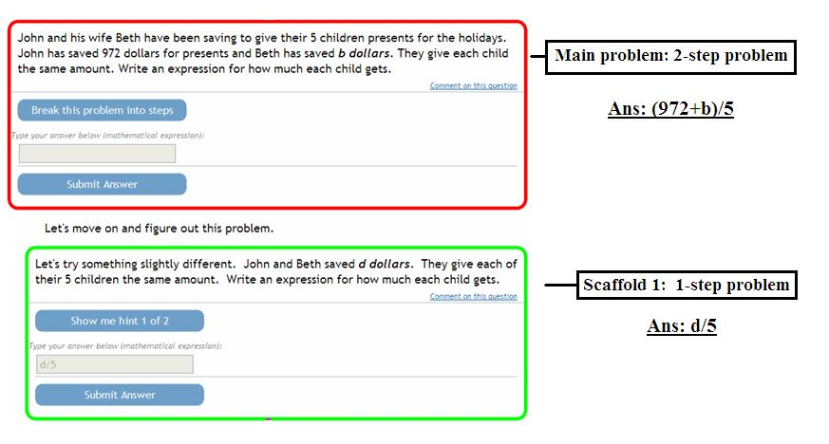
Example problem in ASSISTments tutor
Notes:
Figure 1[1st part]. The goal of the current paper is to report on an extension of the original study that includes substantially more data (from 408 more students) and, more importantly, to present new analyses that address new research questions. [original EDM2016 paper]

Slide 12
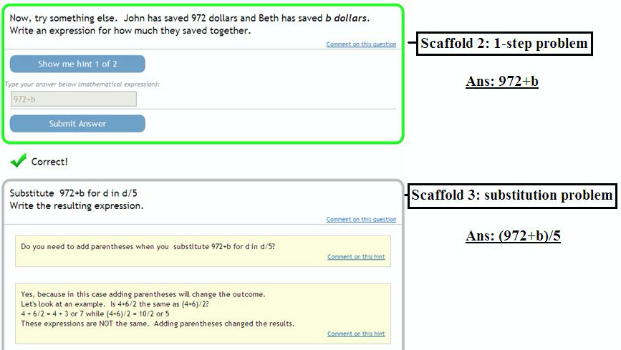
Example problem continued showing
substitution scaffold within problem
Notes:
Figure 1[2nd part]. [original EDM2016 paper]

Slide 13
In Vivo Experiment Design
N = 714 middle school students
  Original study: N = 303 in 2008-9
  Enlarged sample: N = 411 from 2009-12
Random assignment
  Treatment = substitution practice
  Control = 1 operator story practice
Study during 1 class period
Pre-test, instruction, & post-test embedded in a single problem set

Slide 14
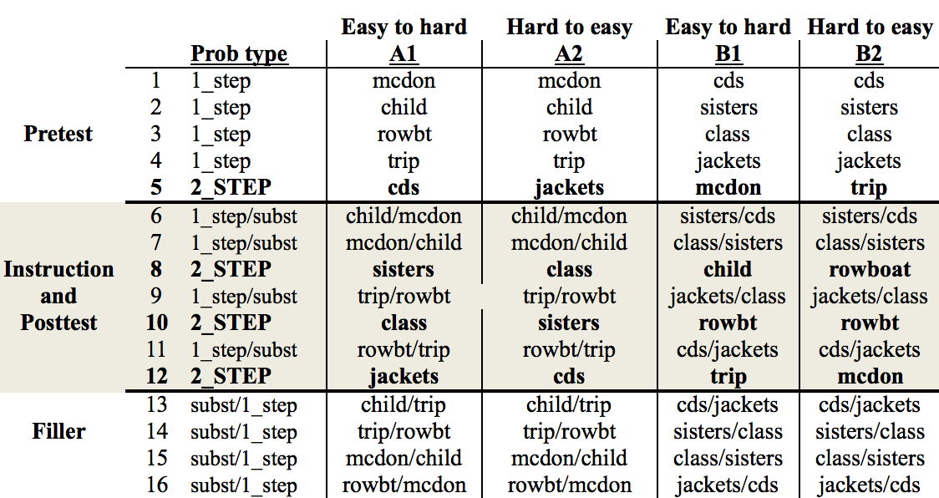
Treatment & Form Variations
Covariate: Pre-test [See rows 1-5]
Target factor: Condition: 1_step v. subst [6,7,9,11]
Context factors: Order: EH v. HE, version: A v. B, study-year: 8 v.9-12
Outcome variable: 2_STEP story problems [8, 10, 12]
Notes:
Experimental design of the problem sets delivered in ASSISTments. [original EDM2016 paper]

Slide 15
Results
5 factor ANCOVA
Main effects
  condition F(1,679)=4.5, p<0.05, d = .21
  pre-test, order, version
Two-way interactions
  pre-test*condition F(1,679)=4.0, p<0.05
  pre-test*order
  order*year
No other higher-level interactions
Notes:
pre-test (F(1,679) = 235.3, p < 0.001), order (F(1,679) = 117.8, p < 0.001), and version (F(1,679) = 19.8, p < 0.001), but study year was insignificant. Significant two-way interactions were found for pre-test and condition (F(1,679) = 4.05, p < 0.05), pre-test and order (F(1,679) = 18.69, p < 0.001), and order and year (F(1,679) = 10.77, p < 0.01). No other higher-level interactions were significant (all p > 0.05).

Slide 16
Interaction is theoretically sensible
80% of students have 1_step competence & better learn 2_step from substitution practice
Notes:
Figure 1. The benefit of substitution practice for symbolizing 2_step story problems is present for the 82% of students with some incoming competence in 1_step story symbolization (at least 40% correct).

Slide 17
Computing composition difficulty:
Is whole (2 steps) greater than “sum” of parts (1 steps)?
Problem name | 2_step solution | 1_step (a) | 1_step (b) | a*b | 2_step | Composition Effect a*b - 2_step 2_step/(a*b) |  | Subst transfer
trip | 550/(h-2) | 0.65 | 0.78 | 0.51 | 0.11 | 0.40 | 0.22 | 0.08
class | 62+62-f | 0.75 | 0.7 | 0.53 | 0.13 | 0.40 | 0.25 | 0.12
jackets | d-1/3*d | 0.58 | 0.54 | 0.29 | 0.16 | 0.13 | 0.56 | -0.02
sisters | (72-m)/4 | 0.71 | 0.63 | 0.45 | 0.32 | 0.13 | 0.72 | 0.15
rowboat | 800-40m | 0.7 | 0.55 | 0.38 | 0.28 | 0.10 | 0.73 | 0.07
children | (972+b)/5 | 0.66 | 0.75 | 0.5 | 0.38 | 0.12 | 0.76 | 0.09
cds | 5*12*c | 0.71 | 0.74 | 0.52 | 0.52 | 0.00 | 1.00 | 0.14
mcdona | 5*h-7 | 0.66 | 0.85 | 0.56 | 0.72 | -0.16 | 1.29 | -0.06
6 problems show a composition effect
2 problems do not – frequent forms mx+b, a*b*x
Notes:
Table 3. Composition effects are found for all but the bottom two problems and the size of the effect is correlated with the amount of transfer of substitution.

Slide 18
Does difficulty correlate with transfer?
5*h-7
d-1/3*d
550/(h-2)
Transfer occurs for problems showing a composition effect
Stronger when parentheses are involved
But oddly the no paren problems are harder …
Notes:
Figure 2. Transfer is limited to the problems that show a composition effect in task difficulty comparisons.

Slide 19
AFM: KC model (Q) is used for both difficulty (β) & transfer (γ) prediction
GIVEN:
pij = probability student i gets step j correct
Qkj = each knowledge component k needed for this step j
Tik = opportunities student i has had to practice k
ESTIMATED:
θi = proficiency of student i
βk = difficulty of KC k
γk = gain for each practice opportunity on KC k
Cen, Koedinger, & Junker (2006)
Draney, Pirolli, & Wilson (1995)
Spada & McGaw (1985)

Slide 20
Discovering new KC models
 | KCs | Recursive grammar skill for 2_step & substitution | Paren skill | Double-ref skill | Item stratified CV (RMSE)
No-transfer | 3 | 0 | 0 | 0 | 0.429
Substitution transfer | 3 | 1 | 0 | 0 | 0.426
Paren-enhanced | 4 | 1 | 1 | 0 | 0.428
Double-ref-enhanced | 5 | 1 | 1 | 1 | 0.416
Next iteration of quantitative CTA:
1) Design instruction to address double ref difficulty
2) Close-the-loop experiment
Notes:
Table 3. Knowledge component learning curve model comparison.

Slide 21
Summary
Quantitative Cognitive Task Analysis
  Difficulty Factors Assessment, Learning Curve Analysis
  Such data is easier to collect & less subjective than qualitative CTA data, such as interviews
Task difficulty variation => KC inferences
  Use same KC model (Q) to explain both difficulty and learning transfer
There isn’t much “E” in “EDM” without interpretation!

Slide 22
Pre-Assessment questions tiny.cc/kenpost
Cognitive Task Analysis leads to improved course design because
  Such analysis helps instructions identify better ways to support learning of the content they know so well
  “Expert blind spot” leaves holes in what instructions know about learner difficulties and how to design to address them
  As much as 70% of the expertise instructors want students to learn is outside of instructors’ conscious awareness
Junior high school students have difficulty in “symbolizing”, that is, in translating a story problem (e.g., “Anne is 800 meters from home & walking 40 meters per minute …”) to a symbolic algebraic expression (e.g., “800-40x”) primarily because
  It is hard to understand the mathematical structure expressed in the story problem
  It is hard to express an understood mathematical structure in algebraic symbols
Which kind of tutored practice produces more learning transfer to symbolizing?
  Tutored practice on translating one operator story problems into algebraic expressions
  Tutored practice on substitution problems, such as “substitute 40x for y in 800-y”
Regarding “close the loop” experiments in EDM:
  We need more otherwise it will remain unclear whether our mining methods mean anything
  We have just enough
  We have more than enough as EDM should focus on mining methods not on scientific insights or applications coming from them
Ultimately, an EDM algorithm is best evaluated by:
  Showing it accurately predicts data through cross validation
  Showing it more accurately predicts data than other existing algorithms
  Showing that use of it or an insight derived from it produces better student learning

